Slide 1

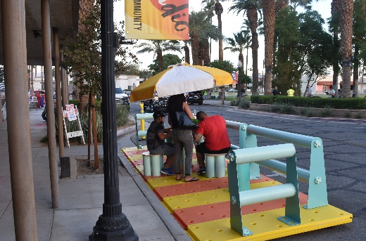
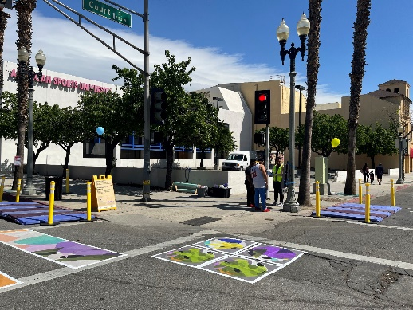
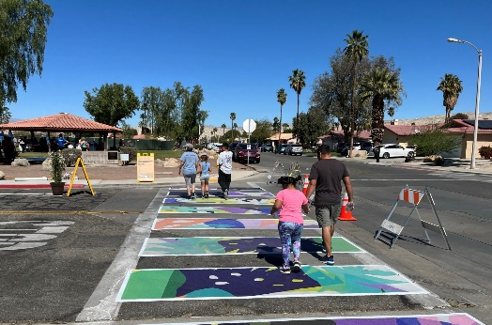
[Day, MM DD, YYYY]
[Location]
Parklet
Instructions
Pick a color theme
Create base map using Google Map/ Google Earth, and use the “washout” feature to lighten the map (It’s under “Format” > “Artistic Effects”
Draw out basic physical features such as the roadway and major destinations
Use the pictures of each Kit element to show each element that will be demonstrated
Update any sample text
Insert your agency logo(s)
Curb Extensions
Artistic Crosswalk
Notes:
Image Retrieved from: http://www.street-plans.com/scag-go-human-demonstration-project/

Slide 2
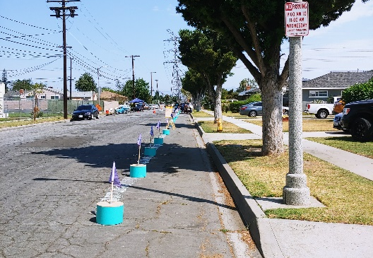


[Day, MM DD, YYYY]
[Location]
Parklet
Curb Extensions
[Insert map]
Artistic Crosswalk
[Event Title]
Separated Bike Lane
In partnership with Go Human, the [organization] invites you to experience temporary safety improvements at [event title] on [Day, MM DD]!
The [Organization] will temporarily transform [location] with [Kit element 1, Kit element 2, Kit element 3 etc] for the day. The event will be held next to the [insert coordinated event], which will feature a variety of fun activities.
Swing by [event title] to participate in this unique one-day installation!
#GoHumanSoCal
#GoHumanSoCal
Base map retrieved from Google Maps
Notes:
Image Retrieved from: http://www.street-plans.com/scag-go-human-demonstration-project/

Slide 3
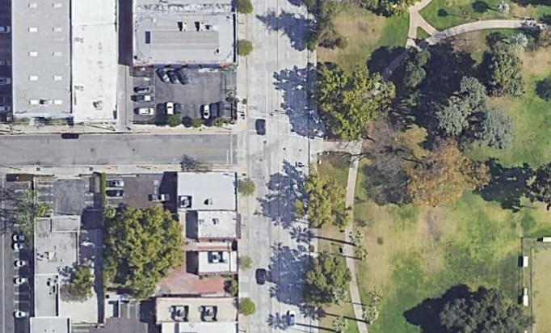

Saturday, April 23, 2022
Fair Oaks Avenue and Valley Street | Next to Central Park
Parklet
Curb Extensions
Valley Street
Artistic Crosswalk
Fair Oaks Avenue
Activate Fair Oaks
In partnership with Go Human, the City of Pasadena invites you to experience temporary safety improvements at Activate Fair Oaks on Saturday, April 23!
The City will temporarily transform the intersection of Fair Oaks Avenue & Valley Street with an artistic crosswalk, curb extensions, and a parklet for the day. The event will be held next to the Jackalope Arts Fair in Central Park, which will feature a variety of fun activities.
Swing by Activate Fair Oaks to participate in this unique one-day installation!
#GoHumanSoCal
#GoHumanSoCal
Base map retrieved from Google Maps
Notes:
Image Retrieved from: http://www.street-plans.com/scag-go-human-demonstration-project/

